Slide 1
Graph Thumbnails: Identifying and Comparing Multiple Graphs at a Glance
hourdjian
Tim Dwyer
Karsten Klein
Kim Marriott
Michael Wybrow
Presentation by –
Gautam Saini

Slide 2
Agenda / Topics
Introduction
The visualization tasks
Design procedure
Studies/ experiments
Results
Conclusion

Slide 3
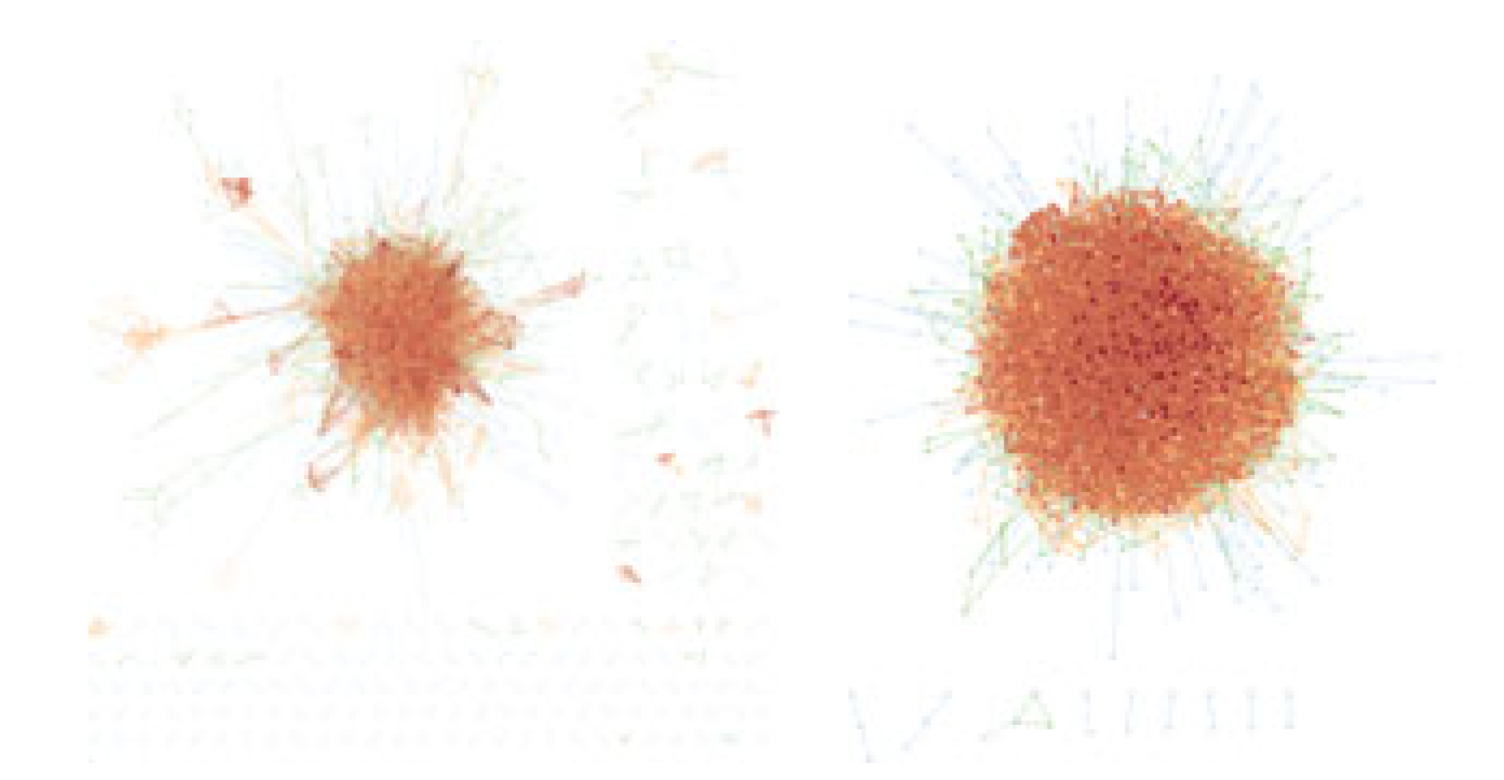
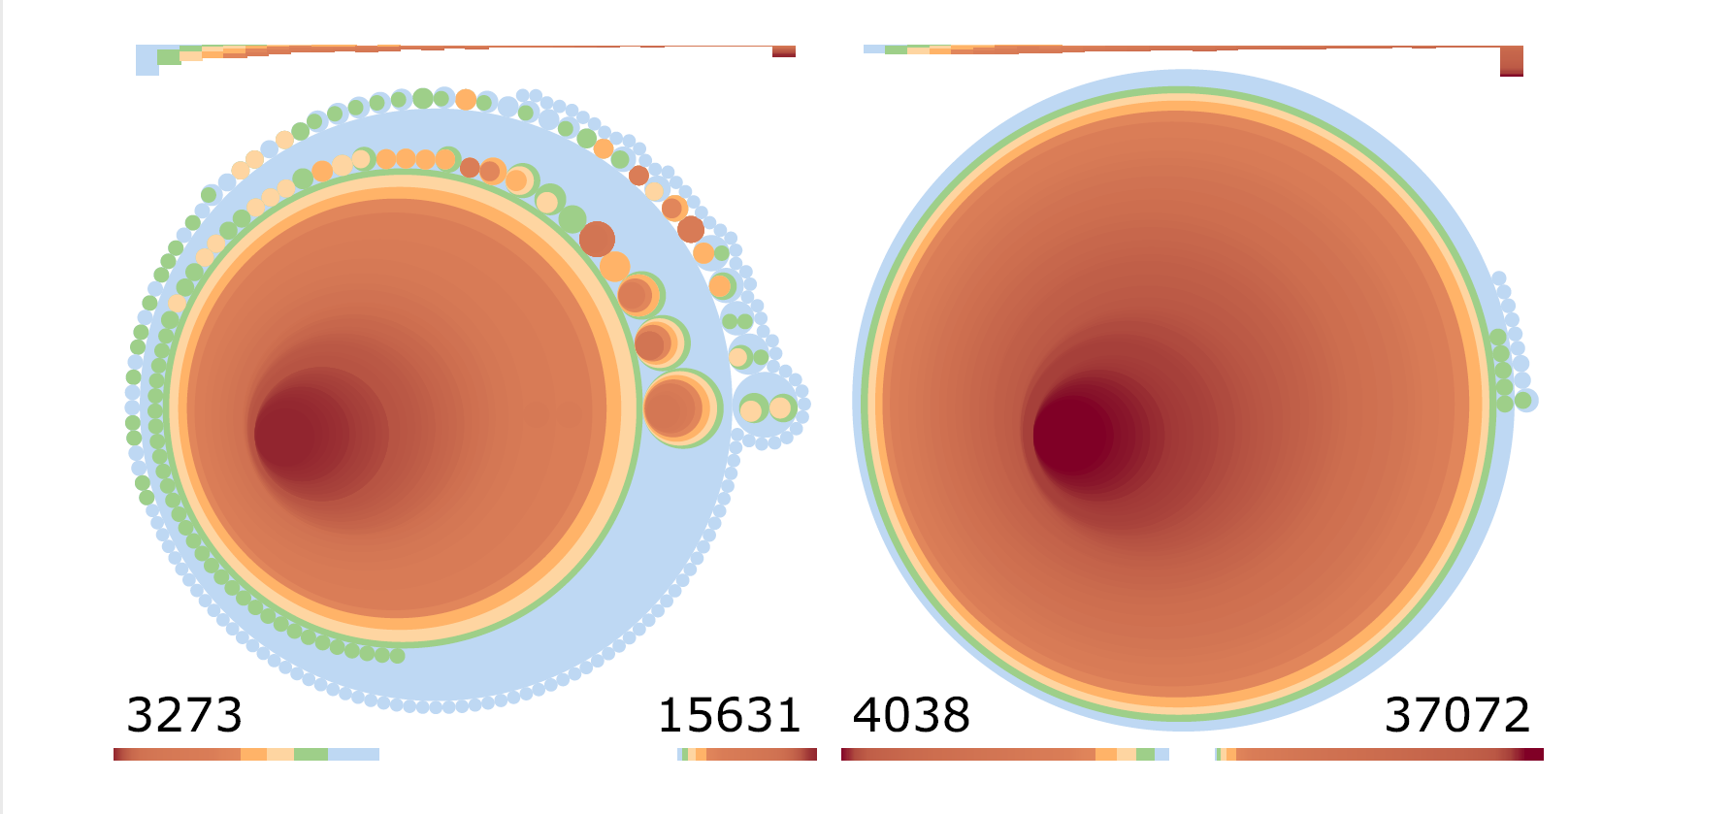
Introduction of Graph Thumbnail
Node and link in large network data
Circle for each node
line for each link
Graph Thumbnails
comparing the structure of networks
vaguely circular blobs changing network
interlinked circular blobs
offers quick comparison and representation
maintains structural information and hierarchy
overview for complex and large networks
Notes:
node-link diagrams are typically drawn with a circle or rectangle mark for each node possibly with a label and a line for each link. Not every visualization task requires a level of detail where every graph element is visible. Sometimes we just want an overview of the large-scale structure of the network. for example, when comparing the structure of networks from different origins or when trying to understand the evolution of a dynamically. The technique presented in this paper is that force-directed layouts of large and reasonably dense networks tend to look like vaguely circular blobs changing network. Maybe it is possible to see that the graph has several interlinked blobs. Maybe some denser cores are visible within the blobs. The Graph Thumbnail representation explored in this paper offers quick comparison and representation. It maintains structural information and hierarchy and can act as an overview for complex and large networks. A typical application would be to browse a set of large networks in order to identify patterns across networks.

Slide 4
The visualization tasks
Identification- Quick identification of a network from a collection
Comparison- Finding similarly structured networks from a collection Overview
Overview- Quickly ascertain key structural information about the overall network structure at a glance

Slide 5
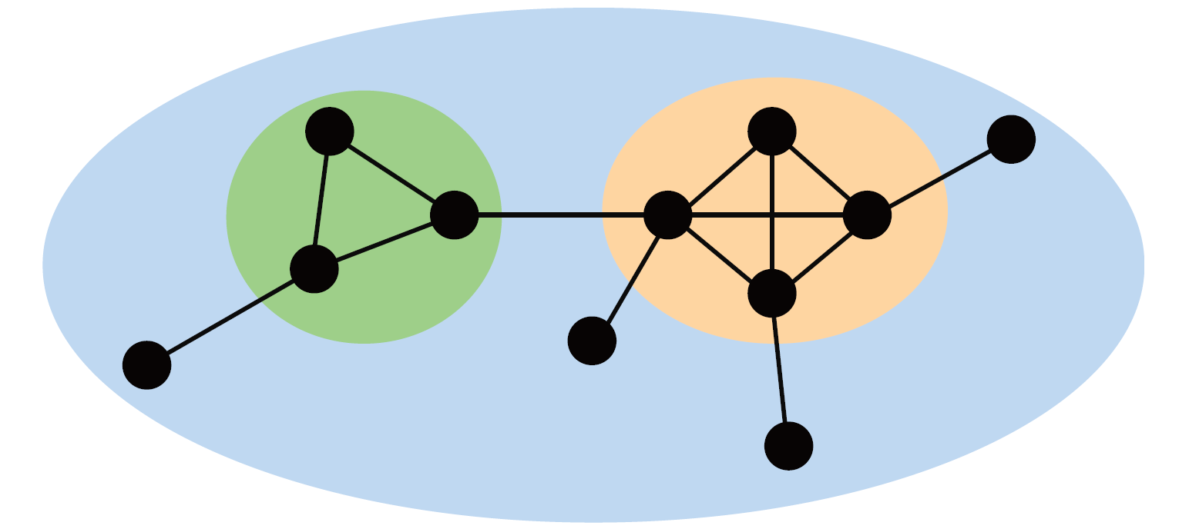
DESIGN: 1. Hierarchical Graph Decomposition: k connected graph
Hierarchical Graph Decomposition: k connected graph
blue – 1 connected component
Green – 2 connected component
Yellow- 3 core component
An algorithm by Batagelj and Zavesnik k-core of a graph is a component of the subgraph found by repeatedly removing vertices that have degrees less than k
Choice of decomposition:
Level 1- singly-connected components.
Level 2- bi-connected components.
Level 3- 3-cores that are contained within a biconnected component.
Levels 4 and up are k-cores k>=3.
Notes:
Our concept for a “thumbnail” representation of a large graph that supports identification, comparison and overview tasks has two key elements: the hierarchical decomposition technique and the visual representation of this hierarchy.
An intuitive approach to finding dense substructures, would be to calculate a hierarchy of k-connected subgraphs in the network
network where all the vertices are connected to each other. The blue ellipse represents the 1-connected component. The green one represents the 2-connected component. While the orange ellipse represents the 3-core component. In this example one 1-connected component contains all the vertices of the network. This network has two 2-connected components within the same 1-connected component. The orange ellipse is also 2-connected since our decomposition yields a hierarchical tree. The sole 3-core component of this network can be found by recursively removing all the vertices that have a degree of 0, 1, and 2 consecutively.
While k-vertex-connectivity of a graph for values of k up to 3 can be tested in linear time. In addition, the decomposition into k-connected components is not unique for k >=4.
algorithm by Batagelj and Zavesnik: A k-core of a graph is a component of the subgraph found by repeatedly removing vertices that have degrees less than k.
final choice of decomposition:
Level 1 is made up of singly-connected components.
Level 2 consists of bi-connected components.
Level 3 is 3-cores that are contained within a biconnected component.
Levels 4 and up are k-cores k>=3.

Slide 6

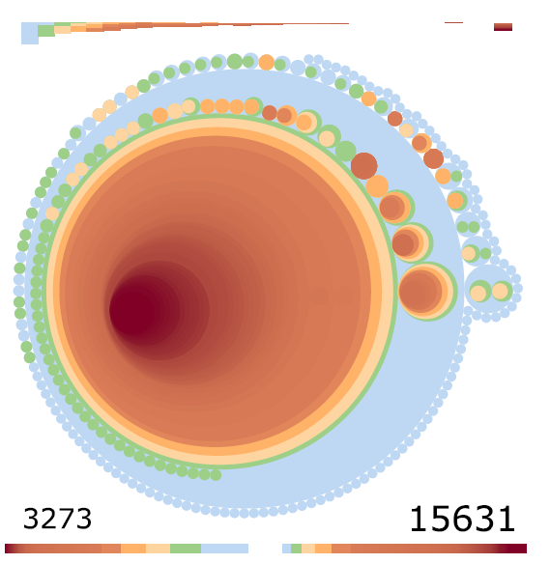
2. Visual Design
nested circle packing
circle area to indicate the size of clusters
Why? - good aspect ratio, a reasonable use of space
Diagram prediction - leaf nodes cluster in nested circles have a larger portion
size of a Graph Thumbnail is independent of the number of nodes and edges- matching of networks with similar structural properties
Notes:
design option we considered involved a nested circle packing. a circle packing still gives a good aspect ratio, a reasonable use of space (R2,R5) and uses circle area to indicate the size of clusters . shows that leaf nodes in nested circles have a larger portion of the overall area

Slide 7
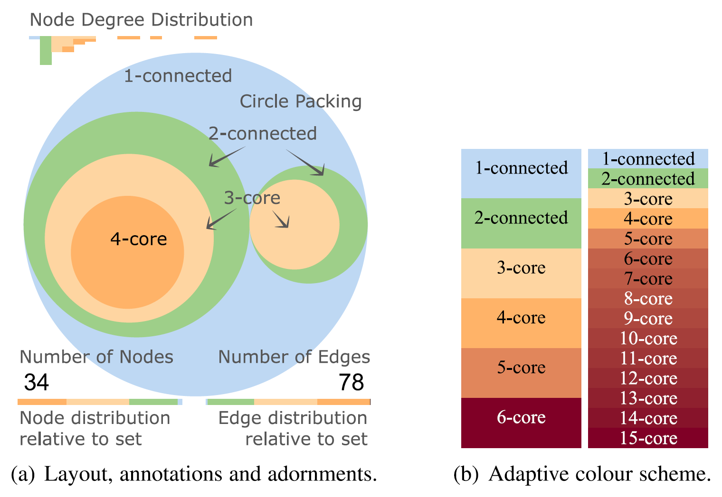
3. Color Scheme
Singly connected – blue
bi-connected – green
3-core children of bi-connected – yellow
Higher - interpolated from yellow to red
If k>= 6 - interpolate from red to maroon
Other properties –
absolute numbers of nodes and edges
Length of bar encodes number of nodes/edges
Node degree distribution
Notes:
After completing of study 1 and 2 the conclusion was:
final colour scheme, singly connected components are blue, bi-connected components are green, 3-core children of bi-connected components are yellow and higher cores are interpolated from red to dark brown. Thus, there is a clear mapping of warmth of colour to density of connectivity within each cluster level.
the colours for the first five levels, and then interpolate from red to maroon in the LAB colour space for levels corresponding to k-cores where k 6, as shown
The size of a Graph Thumbnail is independent of the number of nodes and edges in the network. This allows for matching of networks with similar structural properties independent of size. However, the absolute numbers of nodes and edges are key identifying features of a networkso we choose to add these numbers as labels to the lower left and right corners of the thumbnail.
We add bars below these numbers where the length of the bar double encodes the number of nodes/edges.
We display an inverted histogram across the top of the thumbnail where the height of each bar indicates the number of nodes of a given node degree.

Slide 8
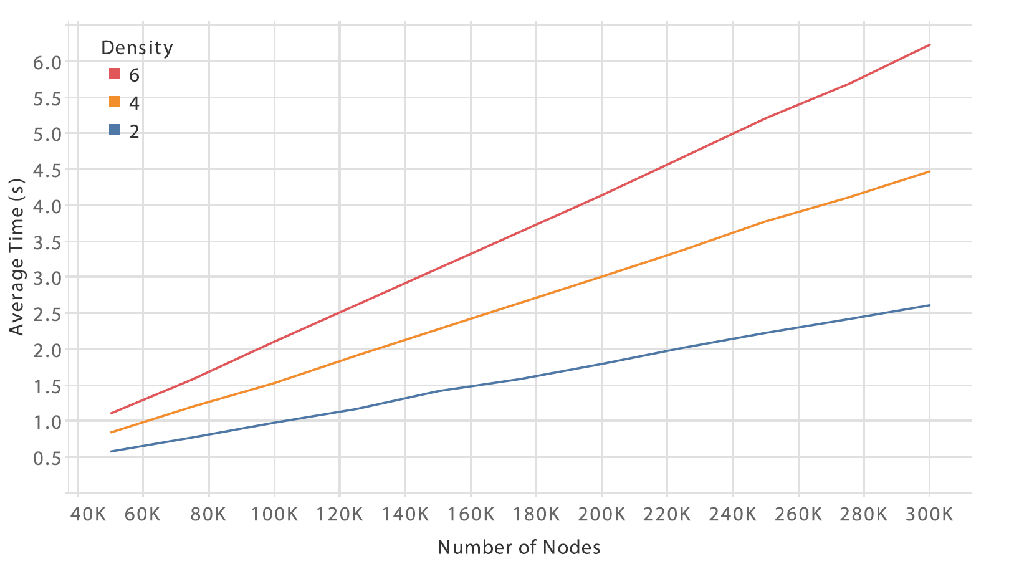
ALGORITHM SCALABILITY
Graph Thumbnails takes linear time in the number of edges.
Hierarchical Decomposition
Canonical Encoding
Circle Packing
Notes:
Hierarchical Decomposition. This returns the different connected and core components of the network
Canonical Encoding. In this stage of the algorithm, we encode the nodes of the tree, which is acquired by the first stage of the algorithm, in order to achieve a canonical ordering.
Circle Packing. We use the D3 [1] implementation of the circle packing algorithm proposed

Slide 9
STUDY 1: IDENTIFYING SIMILARITY
people’s ability to differentiate large graphs with different structural properties using
Graph Thumbnail (GT)
node-link (NL)
matrix (MX) representations
Notes:
first study evaluated people’s ability to differentiate
large graphs with different structural properties using
Graph Thumbnail (GT), node-link (NL) and matrix (MX) representations.
The study aimed to show how much the three
visual representations aided the Identification and Comparison
tasks.
The study had 21 participants: 16 male, 5 female. The participants
were shown an explanatory statement. 7 participants often came across network diagrams,
11 occasionally did, while 3 never did. 7 of the participants
were familiar with the terms cluster and connected
components.
15 participants submitted a 5-star rating of how easy it was to do
the similarity tasks given each visual representation. More than 50 percent
of the participants rated GT on the easy side, while only 33.33 percent
and less than 30 percent of the participants thought MX and NL
were easy respectively.

Slide 10
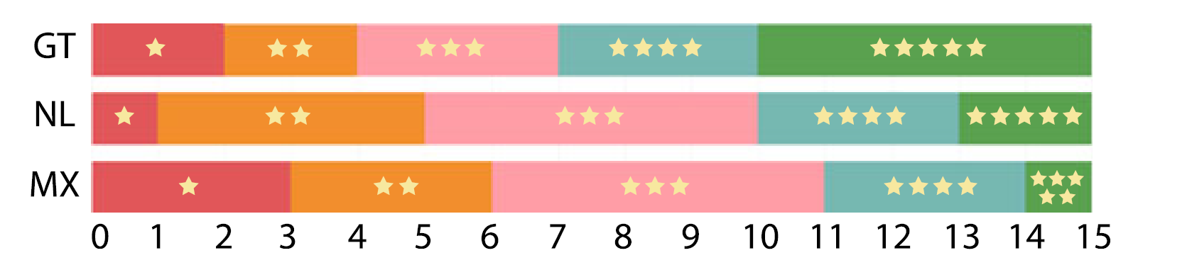
Data observations- Identification and Comparison
In Between two same type of graphs

Slide 11
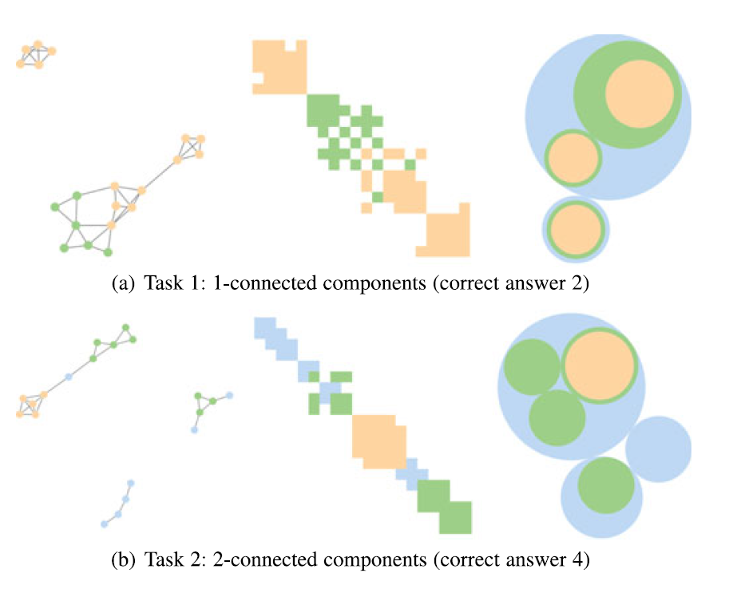
STUDY 2: UNDERSTANDING STRUCTURE
Color study- Colors are better than Grey
MXColour/NLColor are better then MXGrey/NLGrey
Tasks 1:
Find 1-connected components
Find 2-connected component
Notes:
count the 1-connected components of a network.
we expected MXColour to be better than MXGrey. We also expected colour encoding to help MX and NL, thus we hypothesised NLColour would be better than NLGrey
Task 1 and 2 in diagram.
Task 3: Shown a pair of networks, participants had to pick the on with more links.
Task 4: In the final task, the participants were asked to match a
given reference graph shown using GT, MXGrey orMXColour
to one of three NLGrey graphs

Slide 12
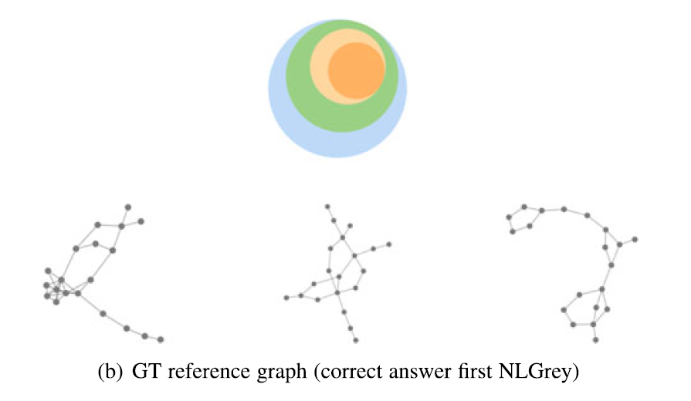
Tasks continue:
Task 3:
Shown a pair of networks, participants had to pick the on with more links
Task 4:
match a given reference graph shown using GT, MXGrey orMXColour to one of three NLGrey graphs

Slide 13
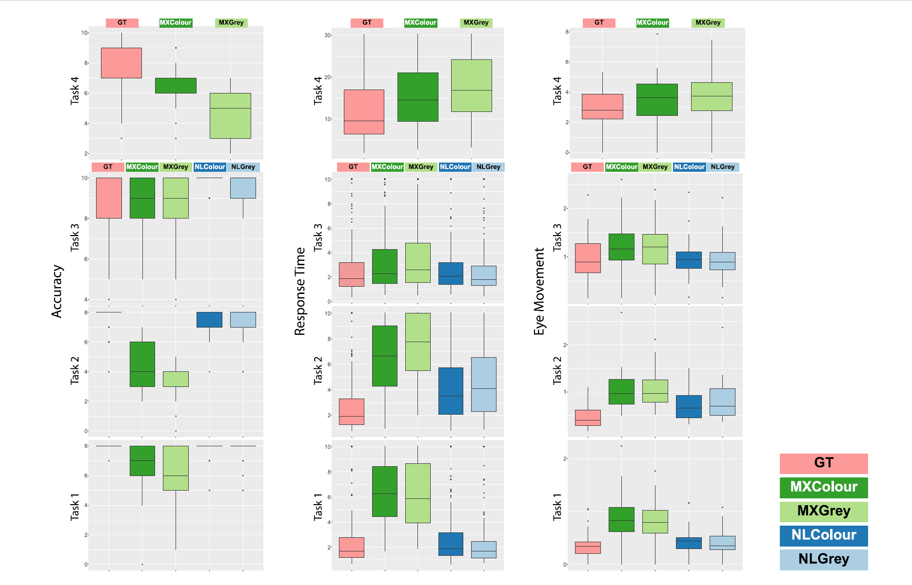
Results
Criteria –
Accuracy
Response time
Eye movement

Slide 14
Use cases
Analysis of protein-protein interaction (PPI) data
Understand the complex mechanism of life and diseases.
Understand the evolution of network structure.
Notes:
We apply our approach to the analysis of protein-protein
interaction (PPI) data. Analysis of PPI is an important step to
better understand the complex mechanisms of life and diseases.
Evolution of DIP database structure for seven organisms (C. elegans, D. melanogaster, E. coli, H. sapiens, M. musculus, R. norvegicus,
S. cerevisiae), each row shows data for one organism (from top to bottom in the listed order). The two leftmost columns show the full DIP dataset for
the years 2008 and 2017, respectively. The remaining columns show the high-confidence core dataset (the most reliable subset of the interactions)
for the years 2008–2017 (Note that at the time of retrieval the full and the core data set for mouse and rat were the same for the years 2008 and
2017, while the sizes given on the DIP web page differed).

Slide 15
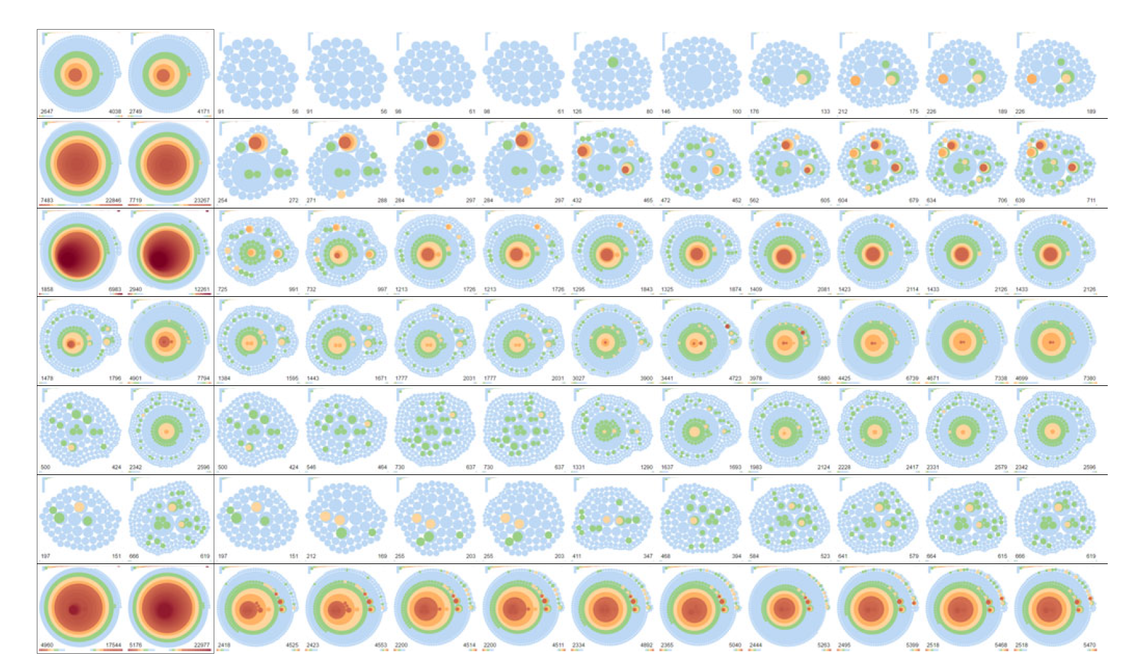
Data observations
two leftmost columns show the full DIP dataset for the years 2008 and 2017
remaining columns show the high confidence core dataset for the years 2008–2017

Slide 16
Conclusion
Graph Thumbnail representation is not a replacement for node-link and matrix representations - required for detailed inspection of local structure
In Identification, Comparison and Overview related tasks- details can be confusing
structural overview better provided by Graph Thumbnails
Graph Thumbnail representation can allow humans to identify graphs with various structures
Graph Thumbnails outperformed both matrices and node-link diagrams in certain Overview tasks, related to connectivity, density and matching
Notes:
The Graph Thumbnail representation is not a replacement for node-link and matrix representations which are clearly required for detailed inspection of local structure\
However, our results show that in Identification, Comparison and Overview related tasks, detail can be confusing and may be better served by a structural overview such as provided by Graph Thumbnails Our results indicate that the Graph Thumbnail representation can allow humans to identify graphs with various structures Graph Thumbnails are at least as indicative of the network structure as matrices and significantly better than node-link diagrams. With a second study, we further evaluated Graph Thumbnails by asking the participants to do certain Overview tasks, related to connectivity, density and matching. The results showed that in most cases Graph Thumbnails outperformed
both matrices and node-link diagrams.

Slide 17
Questions ?

Slide 18

Thank you

